Slide 1
Don’t Worry, Be Happy Webinar June 23rd, 2022 12-1 pm
Dr. Natalie Thomas (Evans)
Adjunct Faculty, Department of Philosophy
University of Guelph

Slide 2
What is Happiness?
What did you jot down as your top 3 sources of happiness?

Slide 3
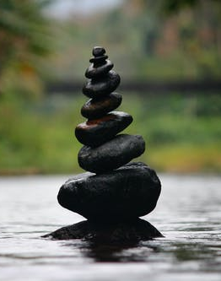
What do first year students say?
Some conclusions about what happiness is from University of Guelph students:
“I believe that true happiness stems from appreciating one's presence and living in harmony with one's body, mind, and spirit. It's difficult to be happy if you haven't achieved peace within yourself. Meditation, for example, is an activity that I have discovered provides me peace.”

Slide 4
What first year students say…
“…people who expect happiness to come and find them and to wash over them unexpectedly is not further from the truth. In fact, it is those who see the joy within the difficulties of life who know genuine raw happiness. People who have the gift of transforming a hardship into something beautiful are the one who truly understand the complexity that happiness is.”
“Evidently, human activity, besides essential activity to stay alive, is based on wanting to maintain or increase levels of happiness. Therefore, it can be considered a driving force of humanity’s will to live.”

Slide 5
What first year students say…
“I still agree with my initial view of the most crucial aspect of happiness being a calm outlook, but I realize now that it’s not as simple as just telling yourself not to be stressed “because everything’s going to work out”. A big part of achieving that peaceful state is determined by your conscious decisions.”

Slide 6
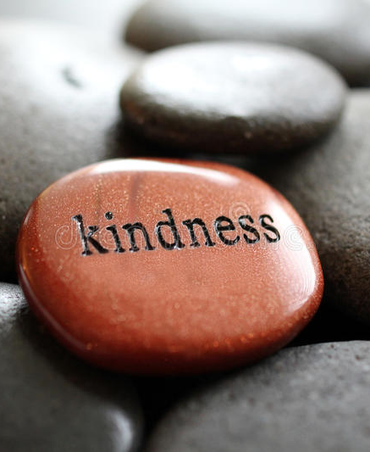
What first year students say…
“…even when it feels like your life is falling apart, that the world may be ending, all we can do is try our best to control the things within our grasp. It’s important to remember that we may not be able to control how others act, feel, react, and treat people, but we do have control over our own feelings, actions, reactions, and how we treat others. The idea of uncertainty is what makes us feel the need to control everything.
But sometimes the best things come from experiences that weren’t expected.”

Slide 7
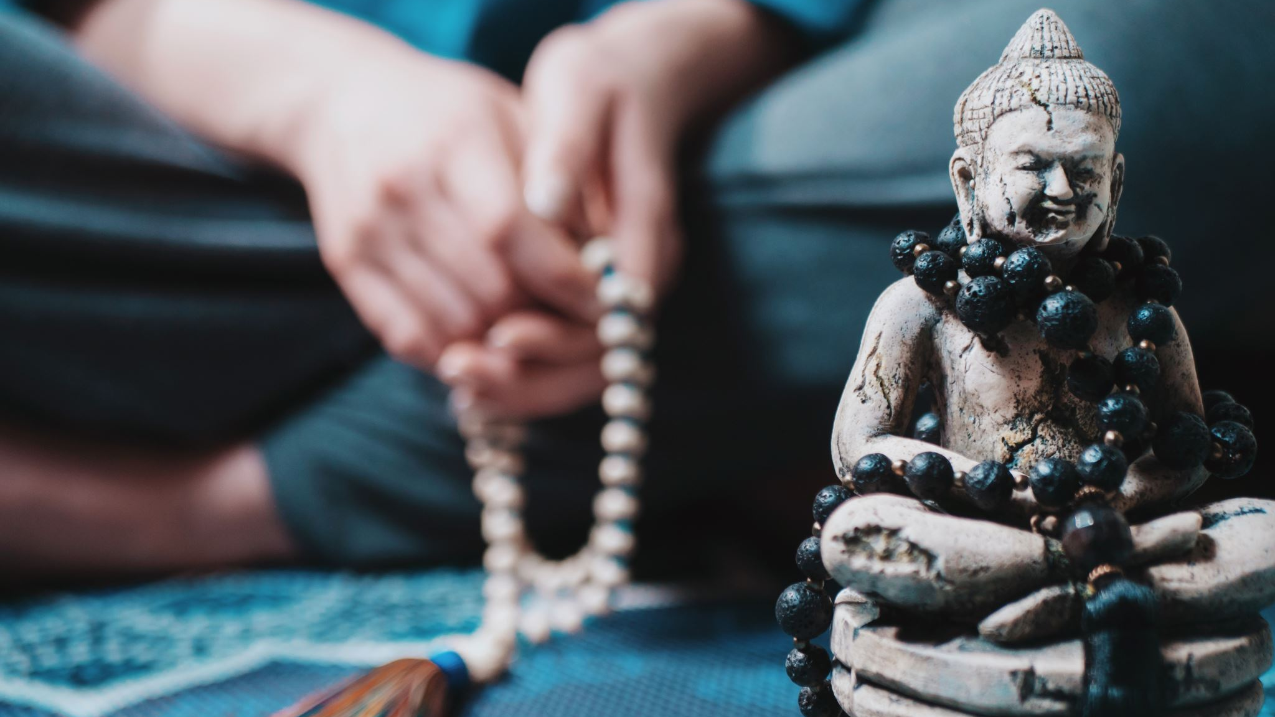
Beliefs about happiness
What are some of your key beliefs about happiness?
What was noticeably absent from students’ conclusions about happiness?

Slide 8
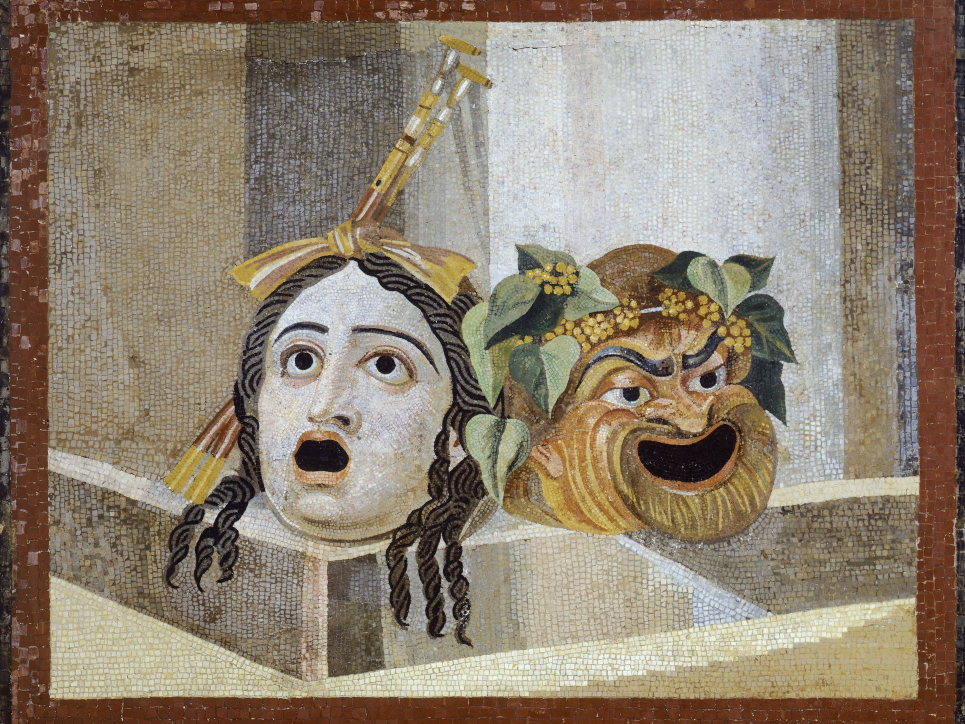
Theories on Happiness: The Ancients
Aristotle, Socrates, Epicurus, Plato and Buddha…
Contemplation, inner sources of happiness, reason & virtues vs hedonism & pleasure
Aristotle: balance between internal and external factors of happiness
The Book of Joy: HH Dalai Lama, Archbishop Desmond Tutu believe that suffering is necessary for joy, as is compassion for others. When we give to others we reduce attention to our own suffering. Joy is our natural state of being.

Slide 9
Research Findings: Happiness Formula (Haidt, The Happiness Hypothesis)
H = S + C + V
H (happiness) = S (biological set point) +C (conditions of your life) +V (voluntary activities you undertake to become happier)

Slide 10
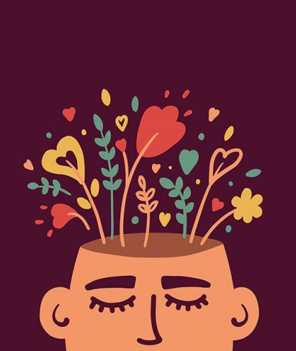
Research Findings on Happiness: Natural Strengths
Contemporary thinkers in positive psychology look at how we can measure happiness (M. Seligman) and how using our natural strengths can increase our happiness
Identifying our natural strengths and finding ways to express them regularly reduce depression and increase health and well-being
Exercises these strengths also gives us meaning and purpose, which are fundamental to happiness in the long-term

Slide 11
Research Findings on Happiness: FLOW
Achieving a state of FLOW (Csikszentmihalyi) can bring peace and loss of a sense of time associated with improved happiness levels (art, dance, singing, playing an instrument, etc.)

Slide 12
Research Findings on Happiness: Mindfulness Meditation and Compassion
Mindfulness Meditation and compassion practices
Meditative practices rewire and retrain our brains to become happier
Just dedicating a few minutes throughout the day to bring to mind something that makes us happy, or viewing something beautiful and staying with it, repeatedly, changes our brain to find it easier to feel happiness (Hanson, positive neuroplasticity)
‘What fires together wires together’
‘what you practice grows stronger’
Compassion and self-compassion practices bring about mental and emotional resilience and decreased anxiety and depression

Slide 13
Research Findings on Happiness: Nature
Screen time: Increases low grade stress, fatigues our brain, lowers our empathy and attention and our length and quality of sleep, health and lifespan
Nature provides the antidote
Being in nature expands our sense of self, relaxes our attention and mind, creates feelings of connectedness to nature and to life (biophilia)
It also improves emotional functioning, alleviates cognitive fatigue, improves attention and feelings of vitality

Slide 14
What doesn’t make us happy?
Affective forecasting problems
Haidt (the Happiness Hypothesis) talks about how we recalibrate our happiness constantly as an adaptive psychological feature that allows us to average out our happiness
What we predict will make us very happy or very unhappy usually doesn’t have the power we expect it to
Those who win lotteries report the return to pre-winning levels happiness within about one year, and large life-events like weddings or buying a home bring a surge of happiness for less than 3 months on average

Slide 15
Conclusions
We can’t magically make ourselves instantly happy, but we can do things to bring about greater levels of happiness in our lives
Ancient and contemporary thinkers and scientists have given us lots of leads, including finding flow and incorporating beauty and increased moments of joy into our days to rewire our brains
Intentionally incorporating practices to improve our happiness and mood can make a marked improvement in how we feel and can change our brains to feel better
We can focus on increasing both short term and long-term happiness by creating a plan and working towards specific goals

Slide 16
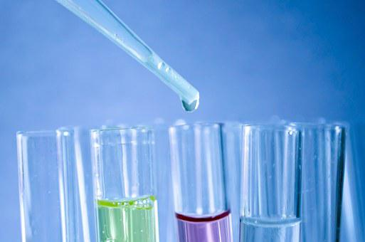
Happify Experiments
Create a list of ‘experiments’ you can try for 1-2 weeks
Keep track of each one in a journal
Rate each out of 1-10 in terms of how happy it made you with some short reflections on what worked and what didn’t work
Think about how you might incorporate some of these into your daily routines
Also try assessing your natural strengths using tools found here:
https://www.authentichappiness.sas.upenn.edu/user/login?destination=node/504
See how you can use these as guides to what happify experiments you might try

Slide 17
Happiness Plan
Spend some time reflecting what already makes you happy, both short term and long-term
What are your happiness goals? Identify specific goals you’d like to meet
Example: I’d like to lose myself in music and dance it out 3 times this week for 10 minutes
Or: I’d like to increase my feelings of calm and peace by learning meditate over the next year
You can use your Happify Experiments and Journal to try out, monitor, record and implement what works for you and check in on certain dates you set for yourself
Resources are available for websites, books, apps and podcasts…but remember, try to get offline and outside too ☺

Slide 18
Resources (also see handout)
Podcast: The Happiness Lab
https://www.happinesslab.fm/
Podcast: The Science of Happiness
https://greatergood.berkeley.edu/podcasts/series/the_science_of_happiness
Martin Seligman’s research: Authentic Happiness
https://www.authentichappiness.sas.upenn.edu/
Check out the Questionnaires area for interactive tests and surveys to help you find out more about your own happiness
Website: Pursuit of Happiness
https://www.pursuit-of-happiness.org/history-of-happiness/

